Slide 1
2024 European Guidelines on CPB in adult cardiac surgery
Hardware, Monitoring and Organ protection
조준우
Daegu Catholic University Medical Center

Slide 2
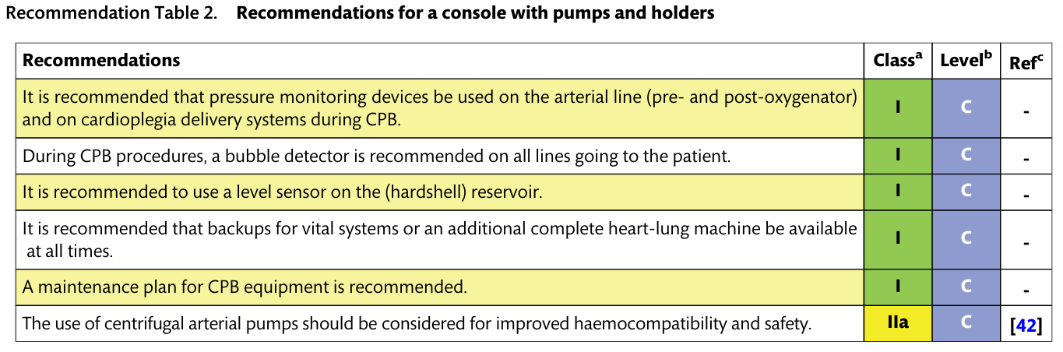
HEART-LUNG MACHINE HARDWARE

Slide 3
HEART-LUNG MACHINE HARDWARE
Console with pumps and holders
  The backbone on which disposable CPB sets are mounted
  Two basic design
    Conventional modular
    Compact miniaturized systems: minimally invasive extracorporeal circulation (MiECC) procedures, extracorporeal membrane oxygenation (ECMO)
  Pump type
    Roller pump
    Centrifugal pump

Slide 4
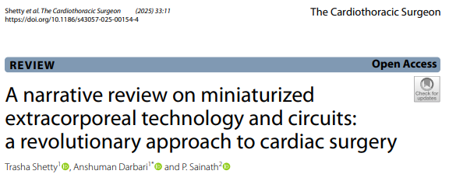
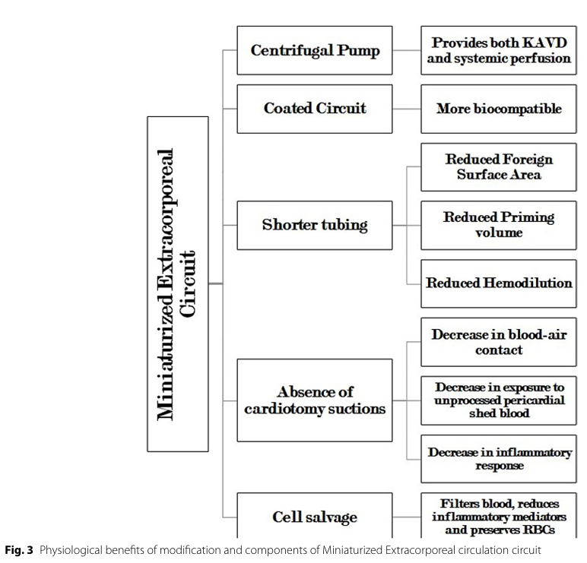
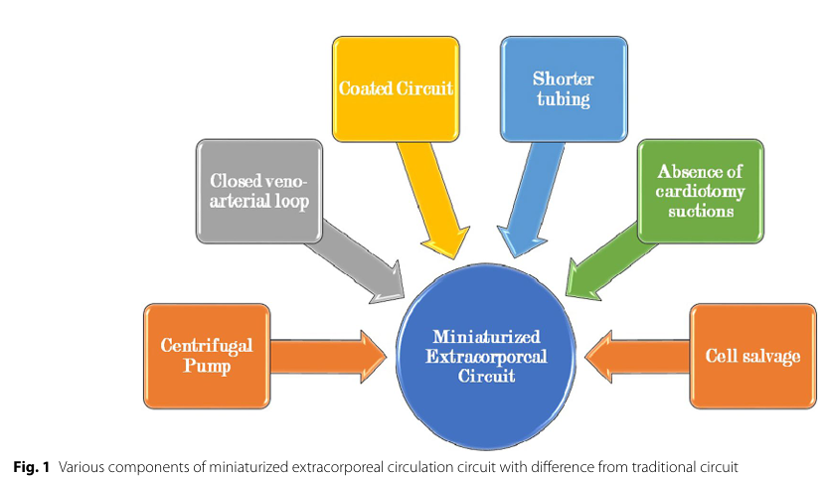
Minimally invasive extracorporeal circulation (MiECC)

Slide 5
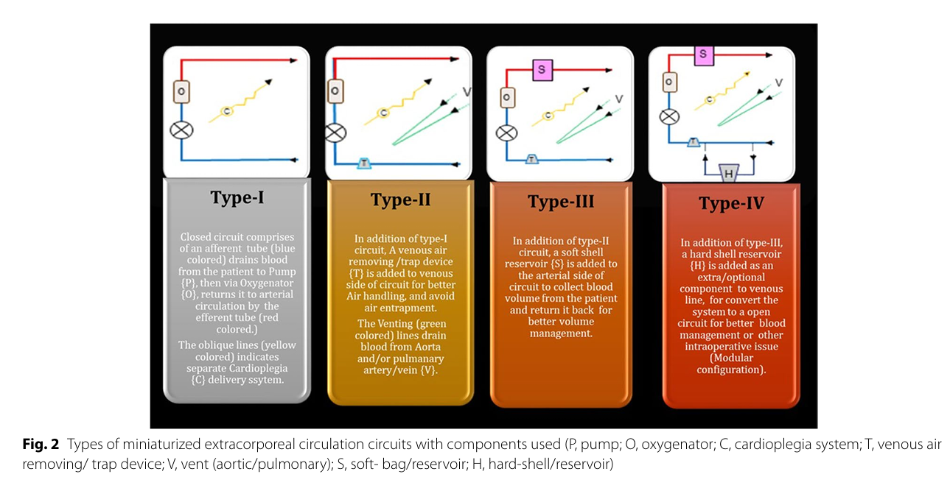
Minimally invasive extracorporeal circulation (MiECC)

Slide 6
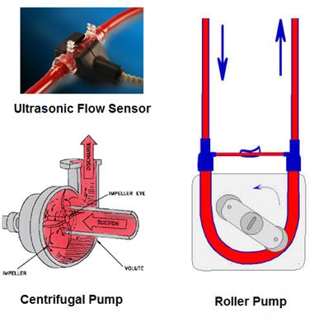
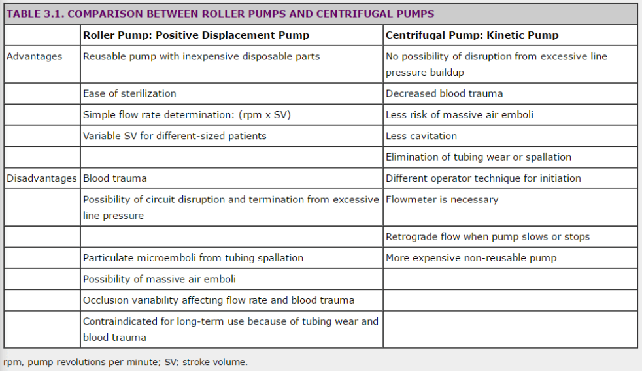
Pump type

Slide 7
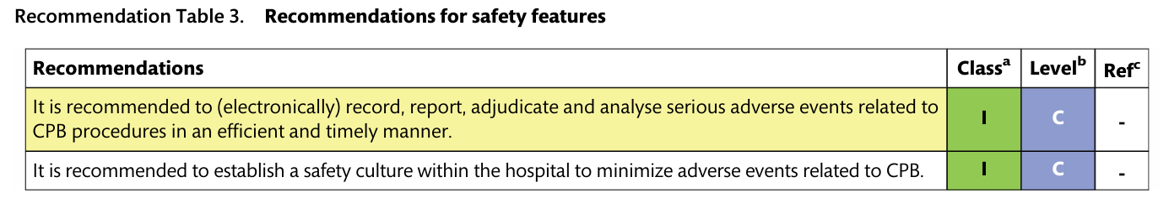
Safety features
Death from CPB-related incidents declined over the last few decades to 1 in 4446–4864 patients
Severe organ injury or death was 1 in 1453–3220 patients
Non-fatal incidents remains a concern and is reported to be as high as 1 in every 58 patients

Slide 8
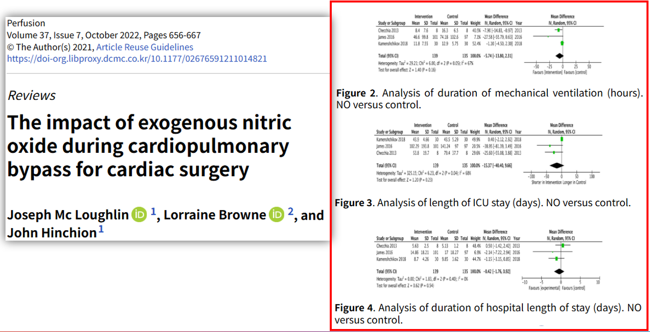
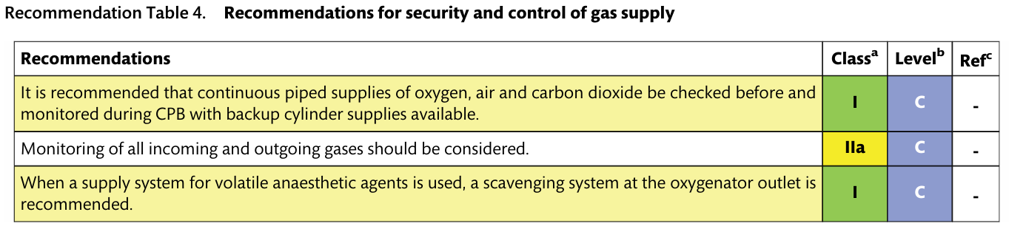
Oxygen and air, carbon dioxide and volatile anesthetics supply
The addition of nitric oxide (NO) to the oxygenator: no consensus
Carbon dioxide should be used to flush the CPB circuit before priming to reduce the number of gaseous microemboli in the priming solution
Potentially at risk of occupational exposure to volatile anaesthetic agents
  Excessive negative pressures must be avoided → resulting in a rupture of the membrane and oxygenator
  -0.5 cm of water (0.37 mmHg) ~ + 10 cm of water (7.4 mmHg) or negative pressures exceeding

Slide 9
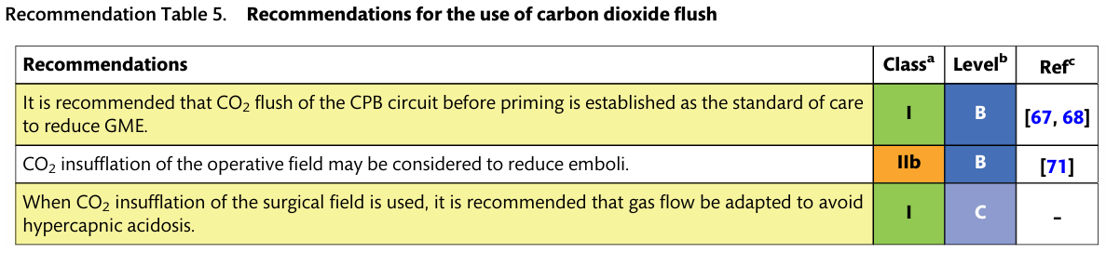
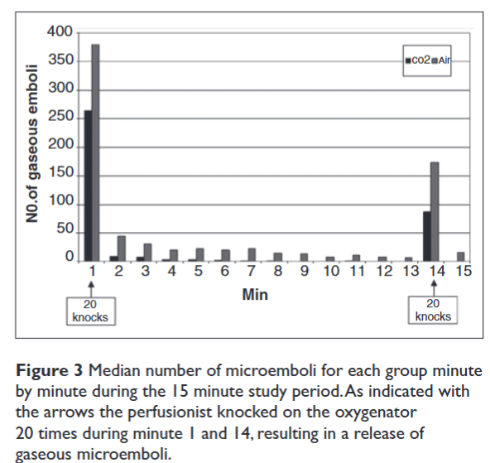
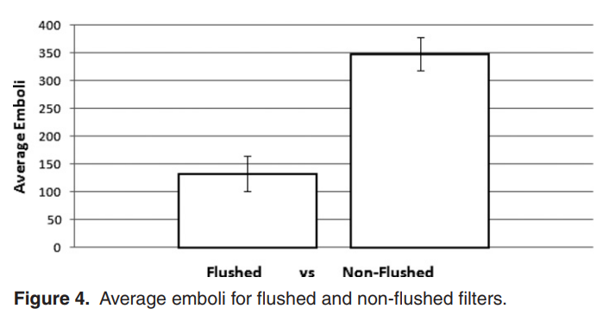
Carbon dioxide flushing of the surgical field
The efficacy of CO₂ flushing of the empty perfusion circuit to reduce gaseous microemboli following priming
JECT. 2009;41:161–165
Perfusion24(4) 249 –255

Slide 10
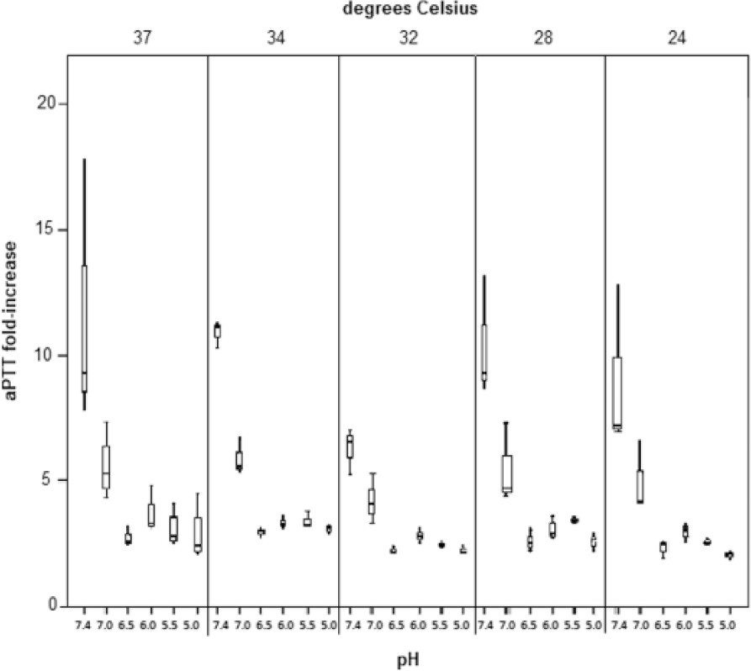
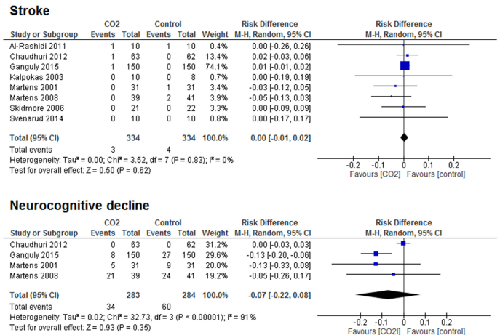
Carbon dioxide flushing of the surgical field
CO₂ insufflation of the operative field
  A beneficial effect on neurocognitive function?
  Concern has been voiced over hypercapnic acidosis: decreased heparin effect and, consequently, to an increased risk of thrombus formation in the circuit
Semin Thoracic Surg 29:301–310
Perfusion. 2017;32(3):214–9

Slide 11
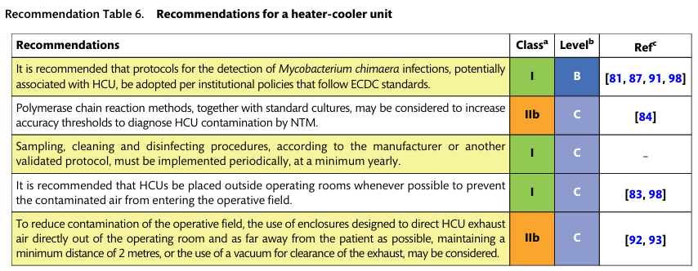
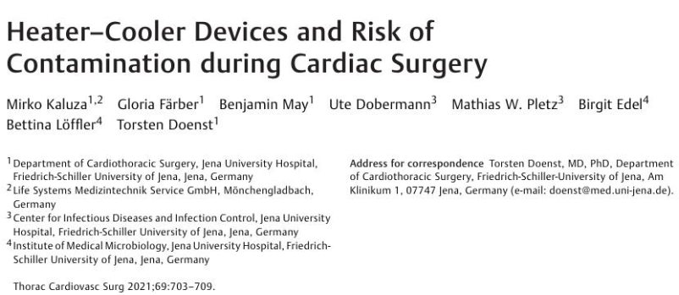
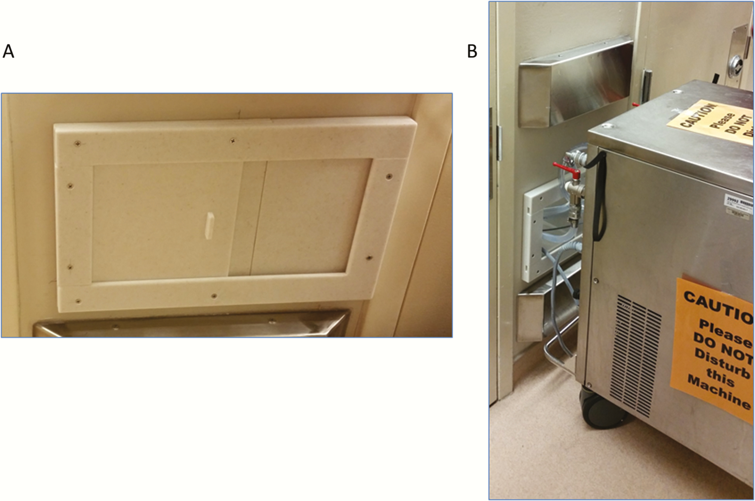
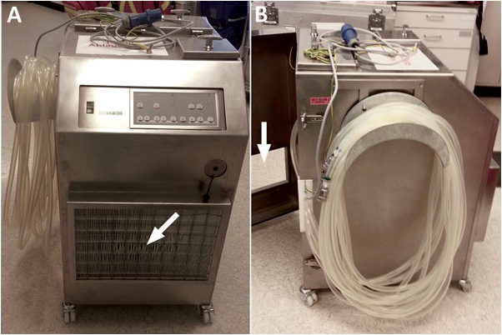

Heat-cooler unit

Slide 12
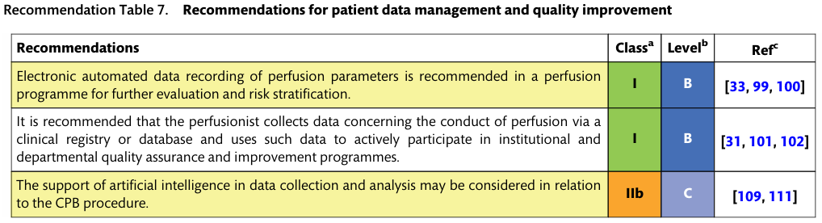
Patient data management systems and quality improvement

Slide 13
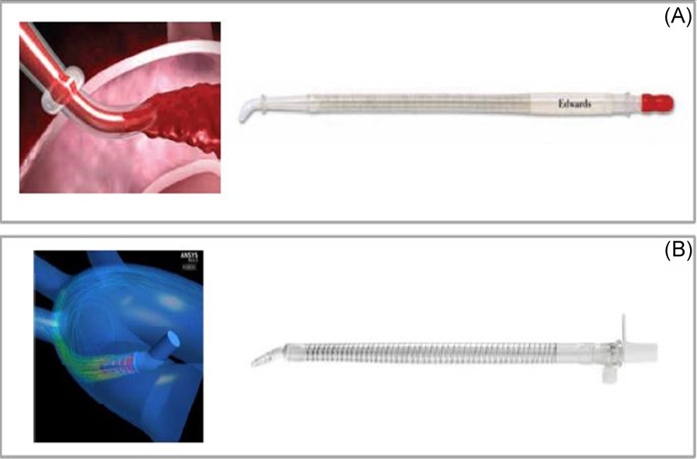
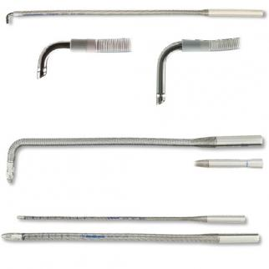
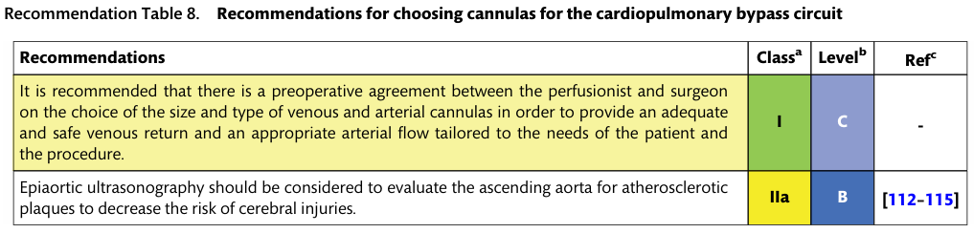
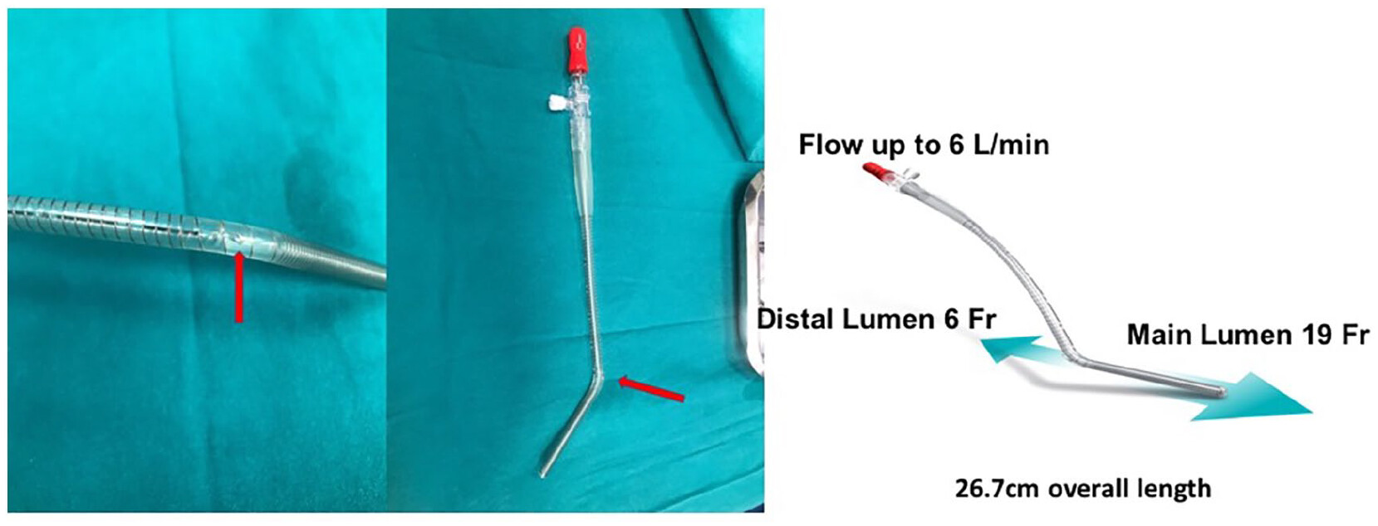
Cannulas

Slide 14
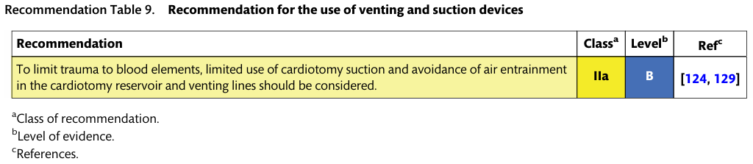
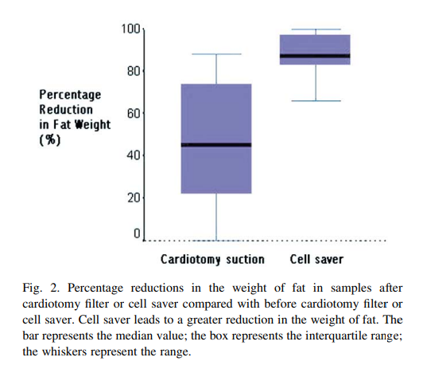
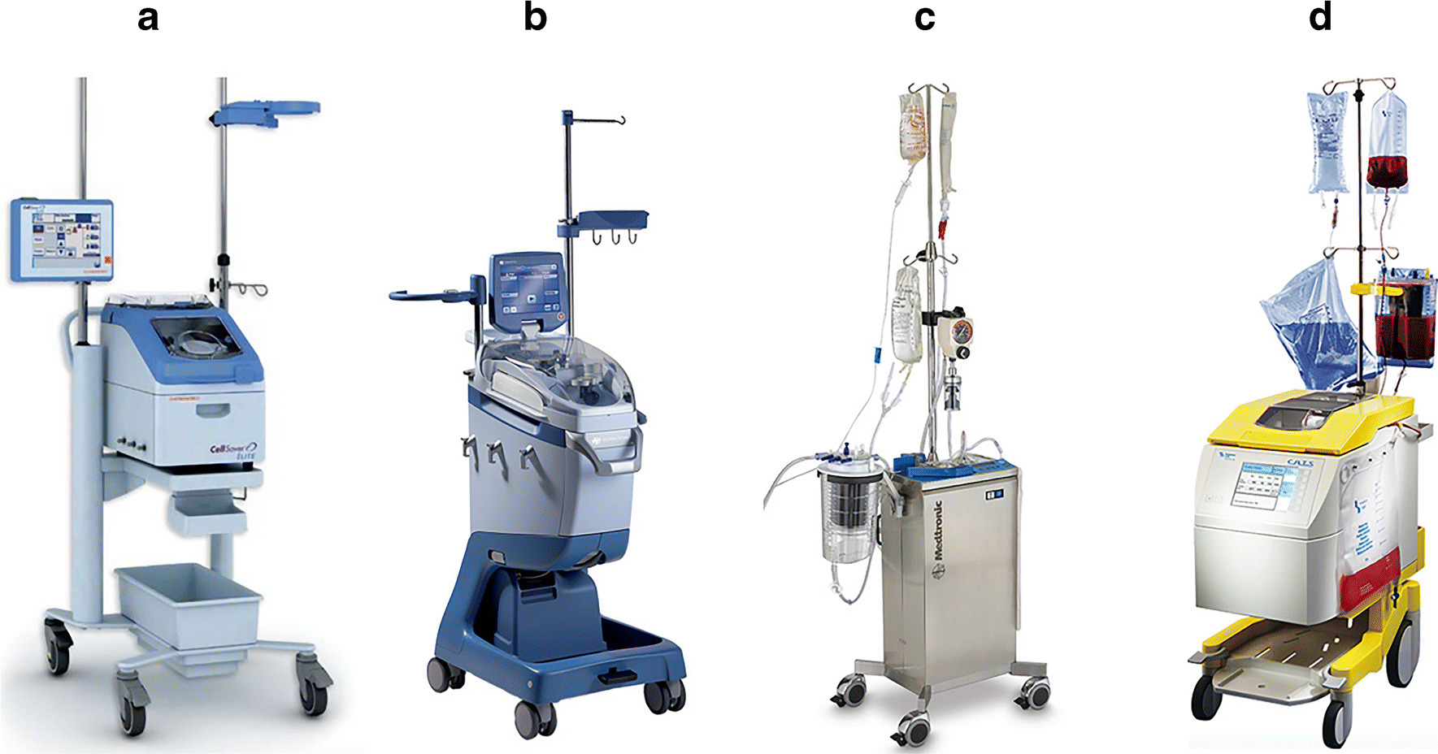
Venting and suction devices
For reducing the need for transfusion of blood products
  But, required negative pressure, blood–air mixing and contact between blood and non-endothelial surfaces activate the coagulation may increase hemolysis
  Venting heart cavities and/or large blood vessels helps optimize the surgical view of the heart structures. This blood is generally less activated because its exposure to damaged tissue is lower than that of pleuropericardial blood.

Slide 15
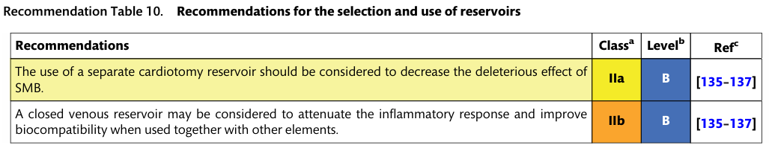
Reservoirs
Two types of reservoirs
  Cardiotomy reservoirs: contains a defoamer and filters to scavenge solid, gaseous and deformable emboli aspirated from the surgical field
  Venous reservoirs
    Open reservoirs are considered safer and easier to operate
    Closed reservoirs are considered better regarding biocompatibility and blood preservation

Slide 16
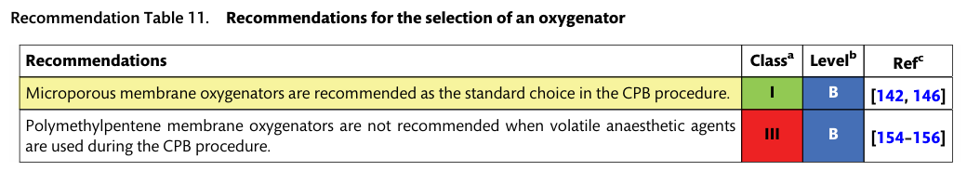
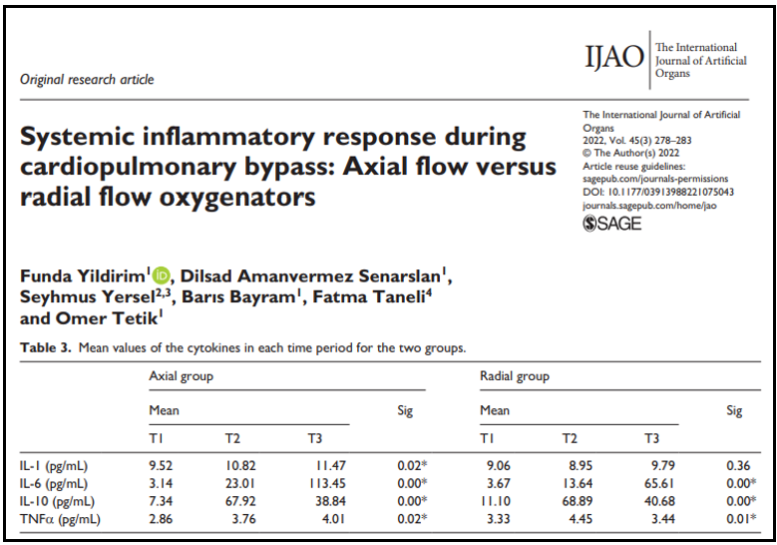
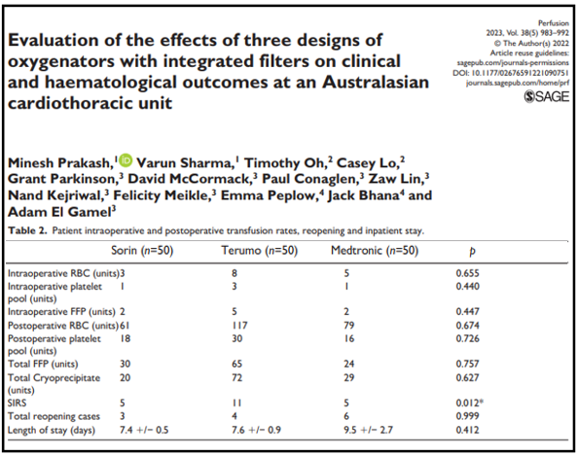
Oxygenators
Membrane oxygenators are the first choice for gas exchange: outperform bubble oxygenators in terms of GME generation, complement activation and neuropsychological results.
Pulsatile or continuous flow
Haemocompatible coating versus no coating: coating was protective in reducing oxygenator failure (0.03% vs 4.3%)
Radial flow oxygenators vs axial flow oxygenators: radial flow oxygenators had lower levels of humoral inflammatory response than did axial flow oxygenators
Polymethylpentene membrane oxygenators is not recommended due to the membrane's low permeability to volatile anaesthetics

Slide 17
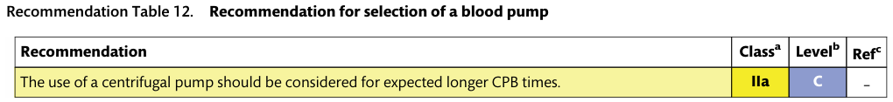
Pumps
No differences were observed between roller pumps and centrifugal pumps
  PRBC transfusions, postoperative blood loss, the length of stays in the ICU and the hospital, deaths
  Thrombin-AT III, F1 þ 2 or thrombin formation
  Neuropsychological outcomes
Hemolysis: R≥C

Slide 18
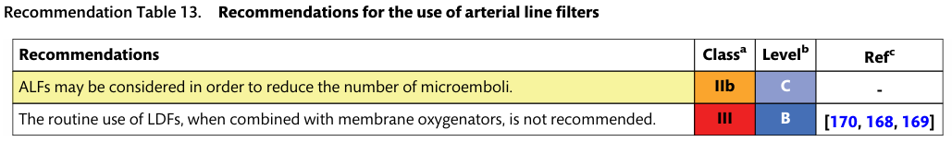
Arterial line filter
A higher incidence of AKI in the LDF (leukodepletion filters) group

Slide 19
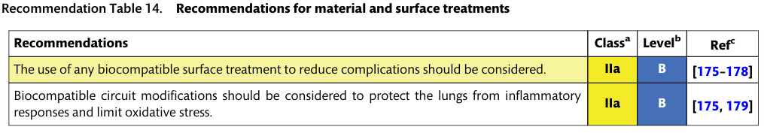
Material and surface treatments
The 3 available modifications
  Biomimetic (bioactive) surfaces with heparin, NO and direct thrombin inhibitors (DTI)
    No differences in postoperative lung dysfunction and mechanical ventilation times
    A significantly shorter stay in the ICU, a reduction in PRBC transfusions, atrial fibrillation, postoperative neurological and pulmonary functions
    Reduce the dose of heparin and protamine→reduction in the systemic inflammatory response and the activation of the coagulation system→reduction in postoperative bleeding
  Biopassive surfaces such as phosphorylcholine (PPC) albumin and poly-2-methoxyethyl acrylate (PMEA)
    Fewer inflammatory responses and less oxidative stress
  Endothelialization of the surfaces aimed at antithrombogenic effects
    Not yet widely used

Slide 20
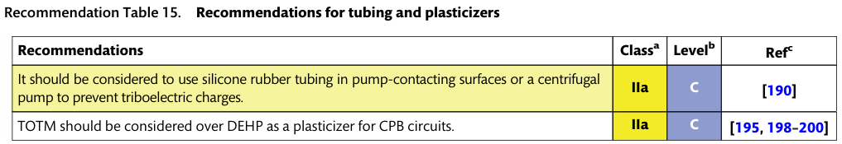
Tubing
A substantial triboelectric charge is generated in roller pumps using PVC tubing → potentially damage electronic components in the extracorporeal pump platform
When using PVC as a biomaterial that contacts lipid-containing substances (e.g. blood), the slow but permanent release of DEHP (di-ethylhexyl phthalate) is expected
TOTM (trioctyl trimellitate) is assumed to be far less toxic than DEHP, this proves that a DEHP substitution is feasible and should be considered
The observed lower plasticizer migration rate of tubing material kept in storage for several weeks

Slide 21
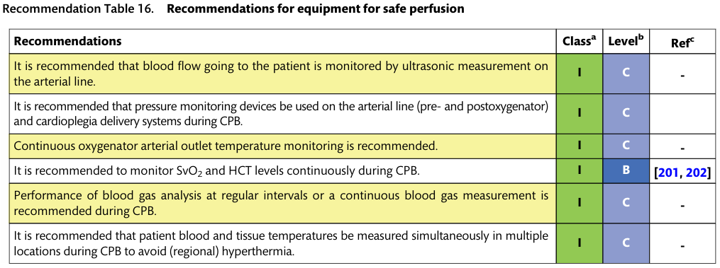
Monitoring

Slide 22
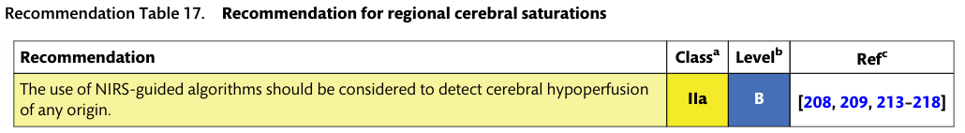
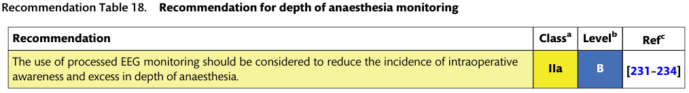
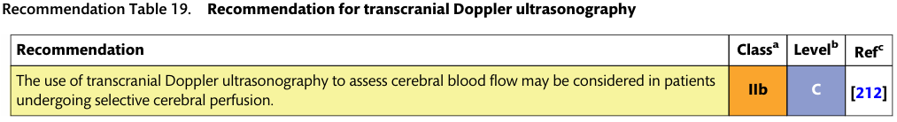
Non-invasive brain monitoring
Low preoperative baseline values (e.g. rScO2 below 50%)
Intra- and perioperative decrements (e.g. rScO2 below 15% of baseline)
BIS, PSI

Slide 23
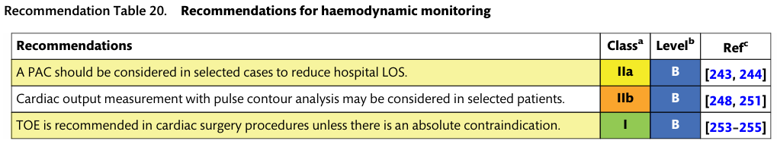
Hemodynamic monitoring
Earlier observational studies reported up to 35–40% of cases receiving a PAC (pulmonary artery catheter), and recent observational studies report between 9% and 28%
Accuracy and precision in non-cardiac and cardiac operations have demonstrated mean percentage errors between 41% and 49%

Slide 24
Trans-esophageal echocardiography
Detection of anatomical abnormalities
Confirmation of appropriate placements of cannulas
Monitoring of adequate decompression of the left ventricle
Diagnosis and management of iatrogenic arterial dissection
Assessment of presence of residual air and adequacy of de-airing before weaning off CPB
In valve surgery, the use of TOE is particularly important for checking the operative result
Absolute contraindications
  Esophageal stricture,
  Tracheoesophageal fistula
  Esophageal trauma
  Esophageal surgery or esophagectomy

Slide 25
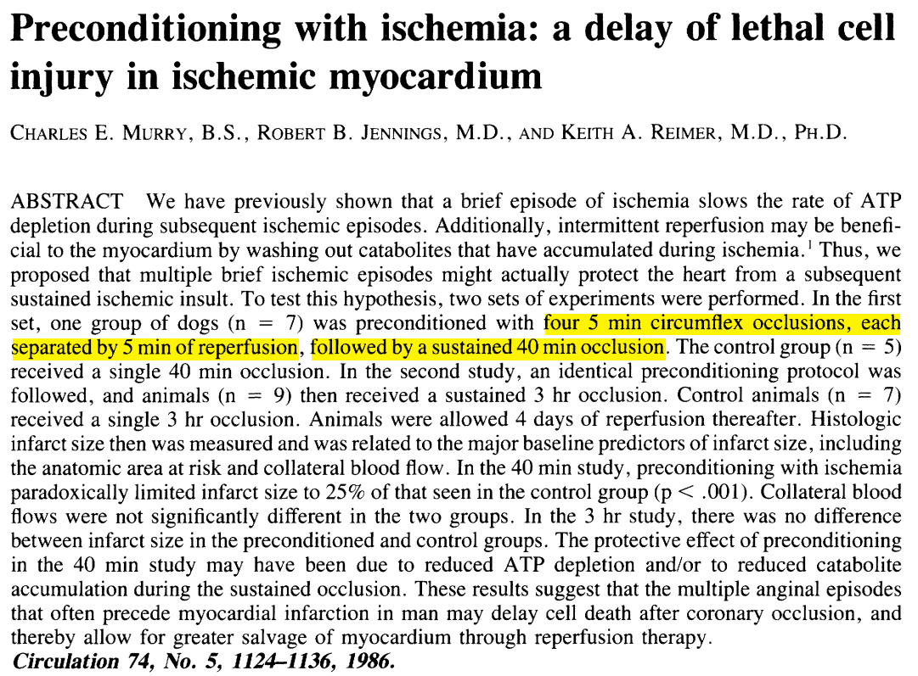
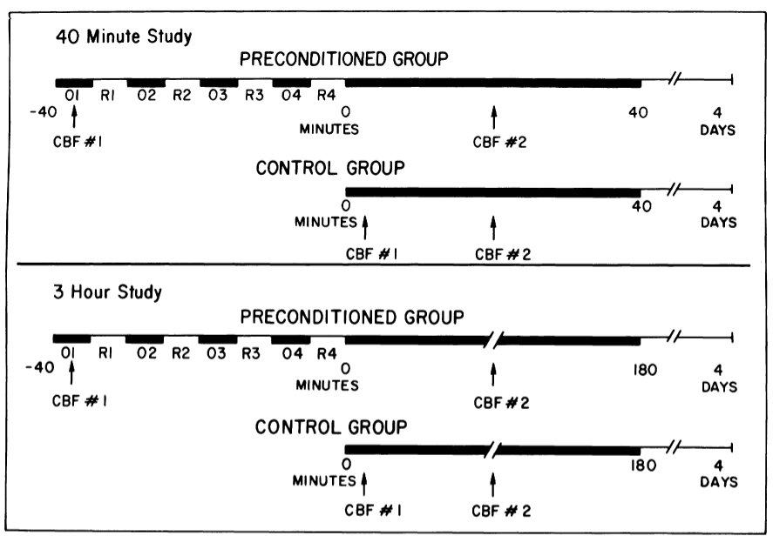
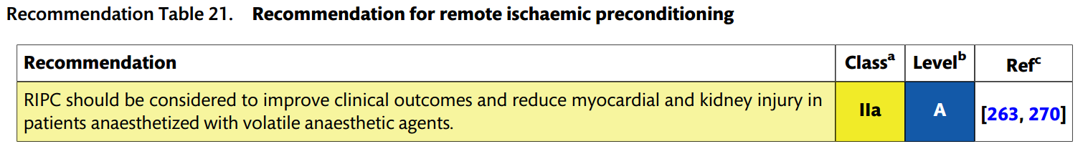
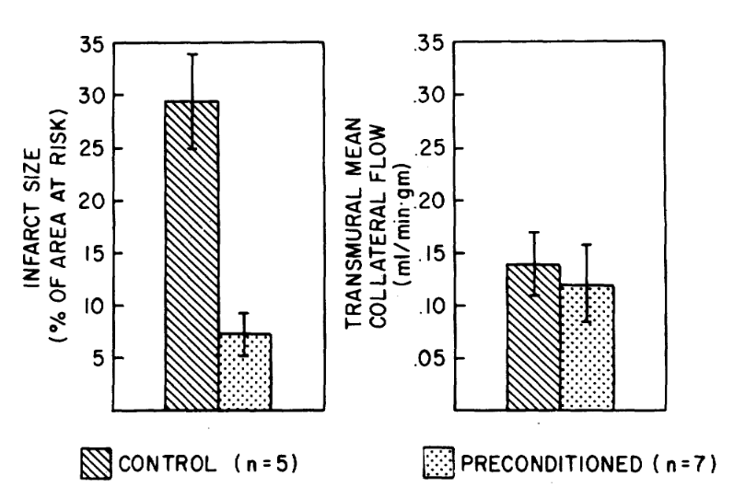
Organ protection
Intermittent clamping of the aorta: carries additional risks and is not a preferred method
Reduced levels of S100 and NSE
Significant effect on the development of postoperative delirium

Slide 26
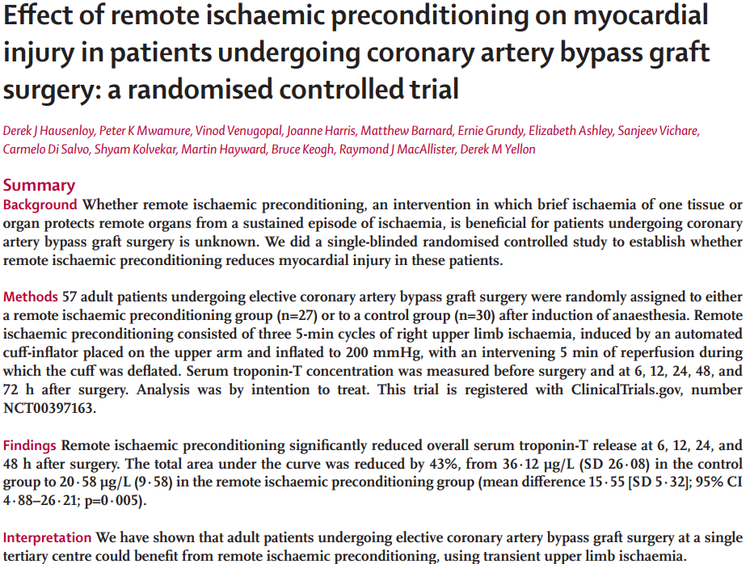
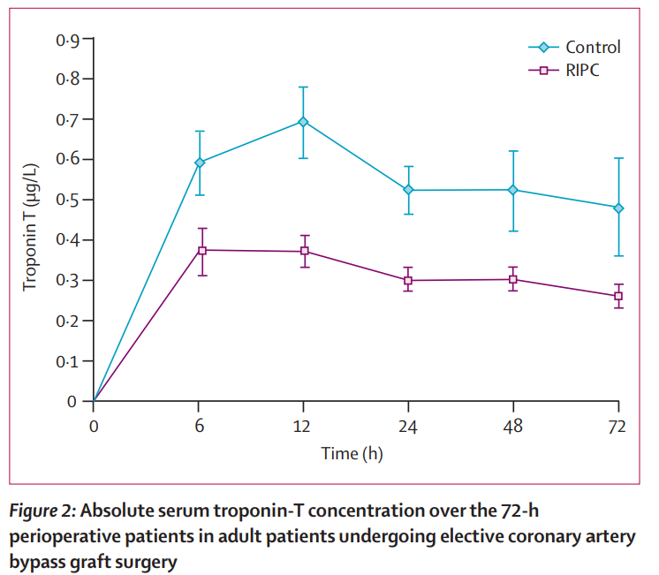
Remote ischemic preconditioning
Lancet 2007; 370: 575–79

Slide 27
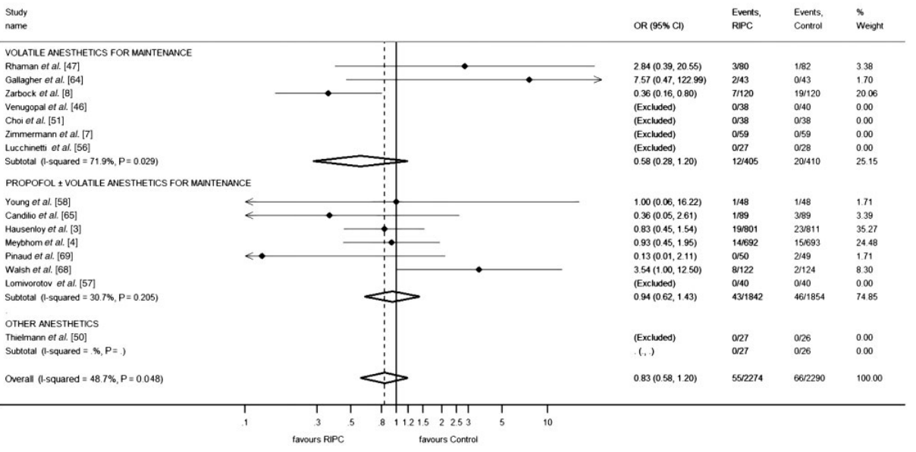
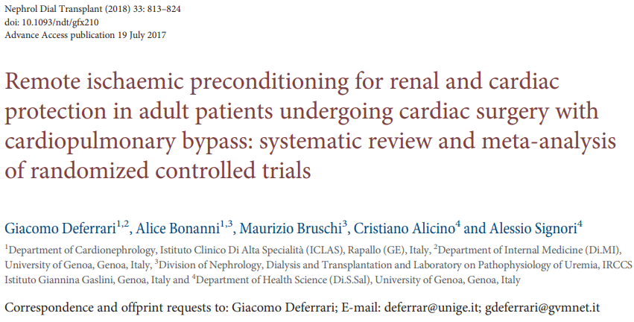
Remote ischemic preconditioning

Slide 28
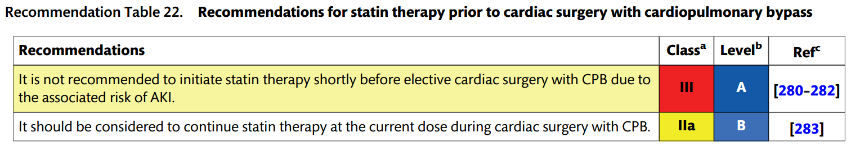
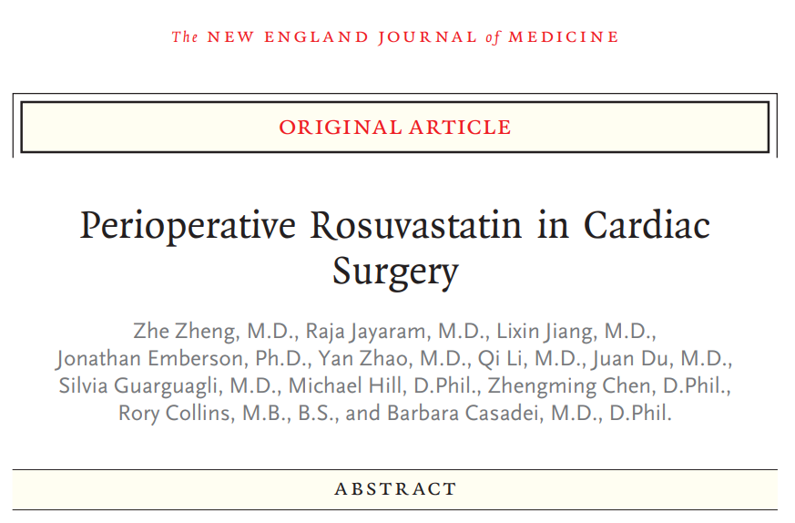



Statins
European Heart Journal (2023) 44, 2322–2331

Slide 29

Beta-adrenergic blockers
Beneficial in terms of early survival
Primarily due to their role in decreasing early postoperative major arrhythmic events

Slide 30



Ultrafiltration

Slide 31



Myocardial management-cardioplegia
Should be considered that specific postoperative parameters, such as hospital or ICU lengths of stay, arrhythmias and mortality rates, are not exclusively influenced by the quality of myocardial protection

Slide 32

Cardioplegia
The main goal of any cardioplegia
  Protect myocardial function from ischaemic/reperfusion damage
  Provide a quiet and bloodless operative field
  Reduction of myocardial oxygen requirements
  Induction of asystole
Components
  Crystalloid versus blood-containing solutions
  Additional components of the solution (e.g. K+-concentration, glucose, buffering capacity)
  Degree of haemodilution
Delivery
  Temperature (cold vs tepid vs warm)
  Multidose versus single dose vs continuous
  Mode of delivery (ante-, retro- and combined simultaneous ante- and retrograde)

Slide 33

Brain protection-temperature control during CPB
Normothermic vs hypothermic (no difference in)
  Delirium
  Postoperative cognitive disfunction (POCD)
  Brain injury
Slow rewarming is associated with a lower incidence of POCD

Slide 34

Kidney protection
It is more important to target DO2, optimize blood flow from CPB and monitor markers of tissue perfusion (NIRS and SvcO2) rather than use vasopressors to increase ABP

Slide 35



Lung protection
Intraoperative strategies to reduce cardiac surgery-associated lung injury
  CPB modifications such as MUF
  Biocompatible circuits or MiECC-associated techniques

